Slide 1


Urinalysis Mailing Procedures
Installation Official Mail Center
Marine Corps Base Camp Pendleton
Updated: 21 September 2025

Slide 2
Topics
References
Preparation of Samples
Secondary Enclosed leak proof container
Mailing Urine Samples
Urinalysis Mailing Process Overview
Drop off Locations

Slide 3
References
Publication 52 – 7 Sep 23
Hazardous, Restricted, and Perishable Mail
DoDI 1010.16 - 15 Jun 20
Technical Procedures for the Military Personnel Drug Abuse Testing Program
MCO 5300.17A -21 May 25
Marine Corps Substance Abuse Program

Slide 4
PUB 52 Explained
Exempt Human or Animal Specimens - Exempt human specimens as defined in 346.12d are not subject to regulation as hazardous materials but when presented for mailing must be triple-packaged in leak-proof (for liquids).
Sufficient cushioning and absorbent materials must surround each primary receptacle containing liquid. Secondary containers for liquids must be leak-proof.
The primary and secondary packaging must be enclosed in a rigid outer shipping container. A single primary receptacle must not contain more than 500 ml of a liquid specimen.
The secondary container cannot serve as the outer shipping container. The secondary container must be marked with the international biohazard symbol shown in Exhibit 346.321. The secondary container must be securely and snugly enclosed in a fiberboard box or container of equivalent strength that serves as the outer shipping container.
The outer shipping container must be marked on the address side with the words “Exempt human specimen” as appropriate.

Slide 5
Preparation of Samples
The IOMC, MCB Camp Pendleton, will only accept urine in their individual boxes.
  Urinalysis samples in batches of 4.
  Urinalysis samples individually prepared.
  Only bring urinalysis samples bundled in batches of four or individually prepared for single packaged samples.

Slide 6
Preparation of Samples for Mailing
All samples must be individually wrapped in approved bags to prevent spillage.
  Do not put more than one box inside each bag. Only utilize the single sample bags.
The Post Office will only check to ensure all boxes are properly sealed for mailing, per USPS regulations.

Slide 7
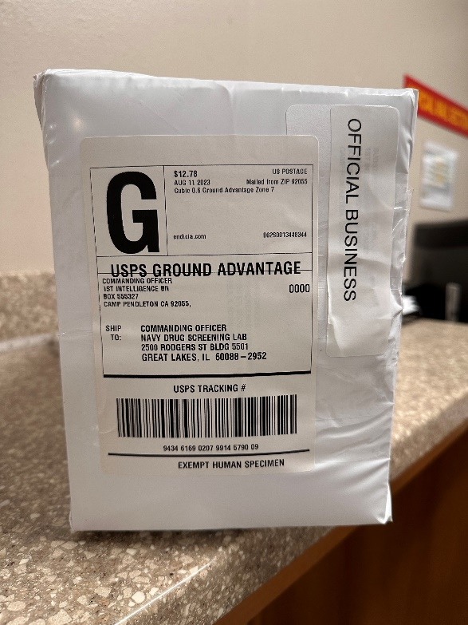
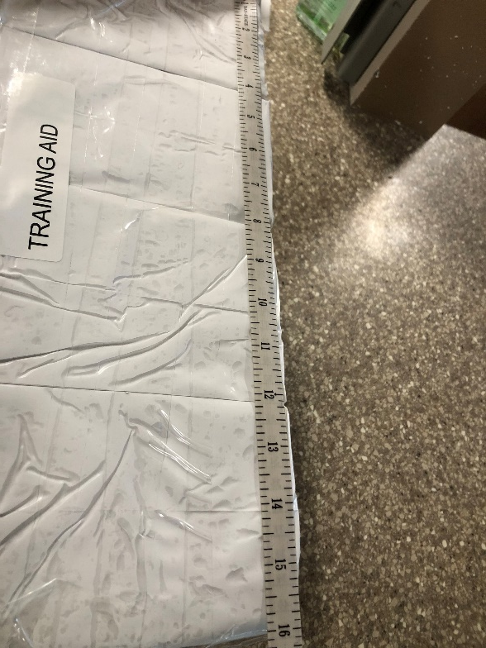
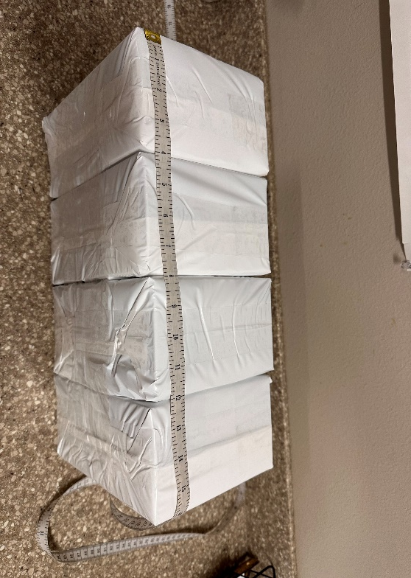
Example of Properly
Prepared Samples
Batch of 4 Samples

Slide 8
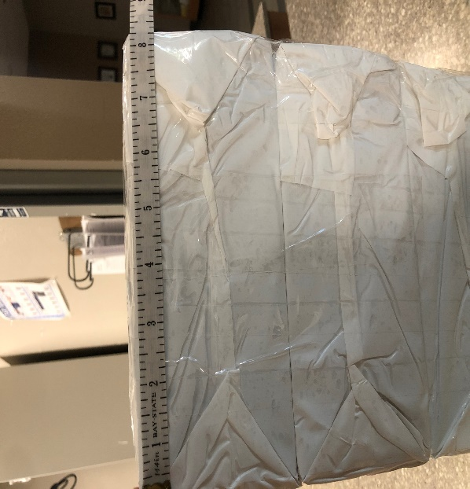
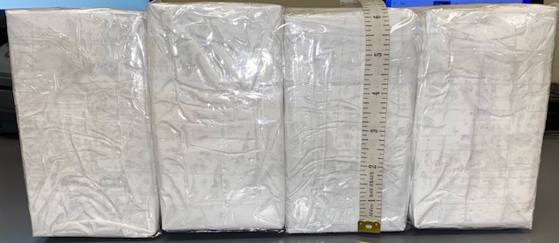
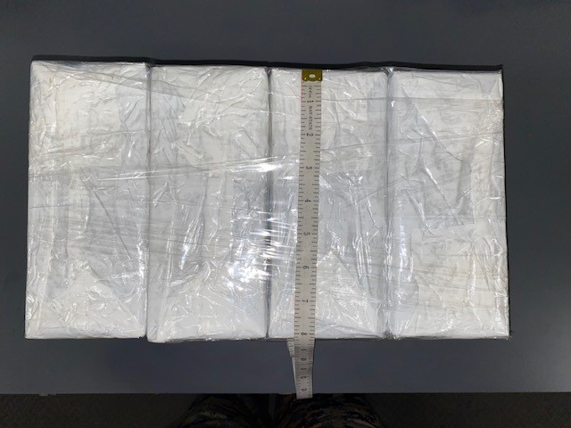
Example of Properly
Prepared Samples
Measurements shall not exceed
16 x 8½ x 6 ½

Slide 9
Mailing Urine Samples
Bring all properly sealed samples to your local Military Post Office/Unit Mail Call in batches of 4 for mailing (if 3 or less bring in separately).
  Local MPO/UMC will assist with the consolidation of samples as needed.
  Will not accept any urine samples in batches of more than 4.
  There is no cap on the total amount of urine samples to be accepted.
  Affix address to each individual urine box (even if they are consolidated)

Slide 10
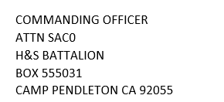
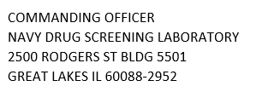
Mailing Urine Samples
Each SACO must bring properly addressed To: and From: labels IOT affix to each of the samples.
Addressing Standards per Military Postal Service Procedures Manual and MCO 5110.4B
  Return and delivery addresses will be typed
  No hand-written or stamped addresses

Slide 11

Mailing Urine Samples
The postage facing side of the bundle shall contain the following label:
  Exempt Human Specimen
  The only authorized endorsement is as shown above.
Notes:
It is the SACO’s responsibility to provide mailing labels and biohazard stickers. Correct and proper packaging and addressing will prevent any delays and make it a smooth mailing process.

Slide 12

Mailing Urine Samples
The biohazard label will not be affixed to the outer layer of the bundle, box or individual samples:
  Biohazard Label
  The biohazard label must be placed on the inside layer of every sample, no matter the quantity.
Notes:
It is the SACO’s responsibility to provide mailing labels and biohazard stickers. Correct and proper packaging and addressing will prevent any delays and make it a smooth mailing process.

Slide 13
Mailing Urine Samples
Each sample box being bundled shall be individually addressed.
  To: Label
  From: Label
  “EXEMPT HUMAN SPECIMEN” Label
Notes:
It is the SACO’s responsibility to provide mailing labels and biohazard stickers. Correct and proper packaging and addressing will prevent any delays and make it a smooth mailing process.

Slide 14
Urinalysis Mailing Process (Multiple Sample Boxes)
Once urinalysis is complete:
Prepare and seal each sample box.
Ensure each box is properly sealed in a secondary leak proof container.
Bring samples to MPO/UMC
Do not consolidate samples into a larger box.
Ensure you have required labels: To, From, and Exempt Human Specimen labels on the box
Biohazard labels shall not be affixed to outer layer of the samples.

Slide 15
Urinalysis Mailing Process (Multiple Sample Boxes)
Left over sample boxes are to prepared individually for shipment.
A Postal Marine will assist with consolidating samples by batches of four.
SACO will provide proper labels
Labels will be affixed only to the postage facing box.

Slide 16
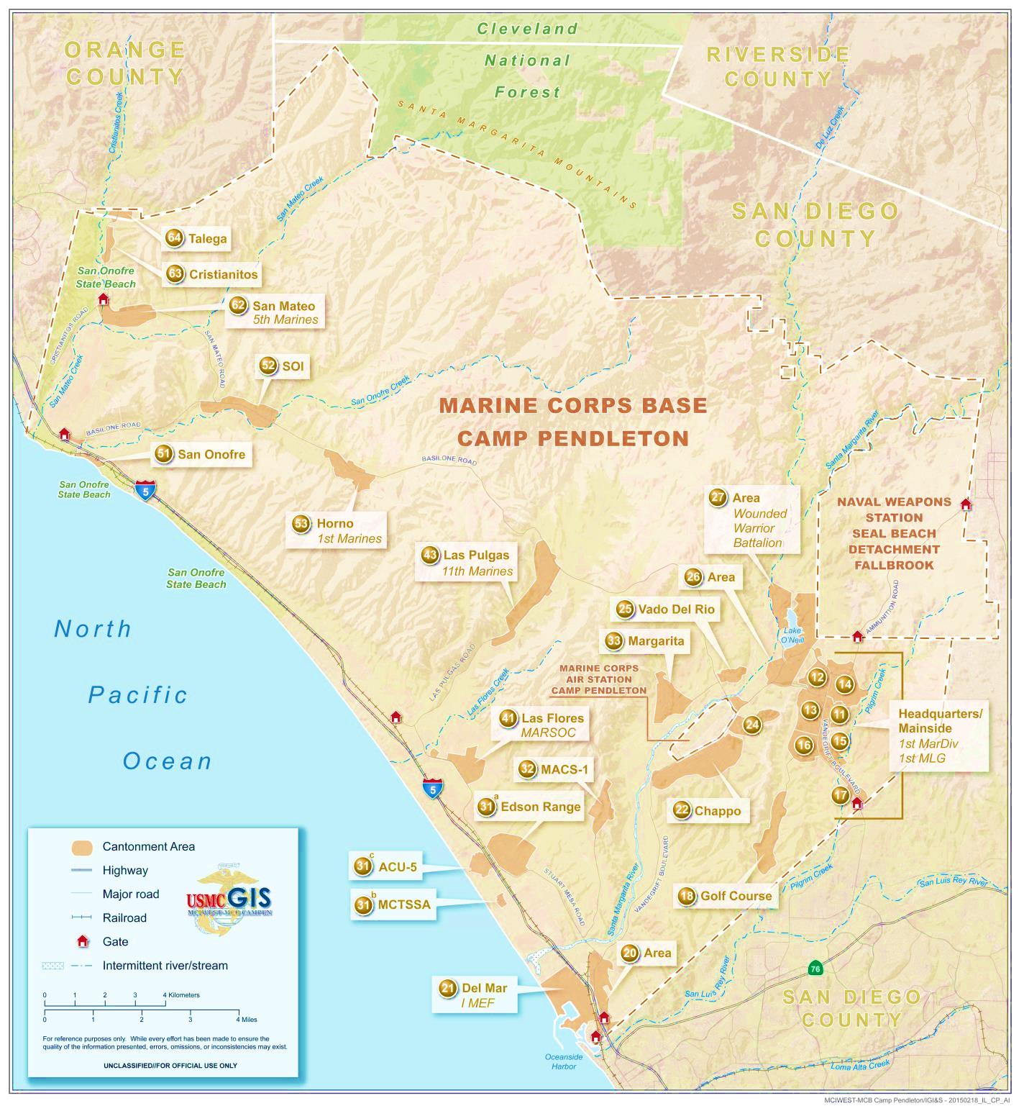
CAMPEN MPO Locations
53 Area MPO
BLDG 53507
33 Area MPO
BLDG 33106
14 Area MPO
BLDG 1482
43 Area MPO
BLDG 43507
41 Area MPO
BLDG 4153
22 Area UMCS
BLDG 220106
21 Area UMCS
BLDG 210636
16 Area MPO
BLDG 16840

Slide 17
Point of Contact
Installation Official Mail Manager
WO Rodriguez, Dana L.
dana.rodriguez@usmc.mil
Assistant Installation Official Mail Manager
GySgt Jackson, Joshua
Joshua.i.Jackson@usmc.mil
Office: 760-725-5713
Or 760-763-1196
MCIW_MCB_CPEN_POSTOP@usmc.mil
Drug Demand Reduction Coordinators
Mr. Ernest Rose – Office: 725-5330 C:760-681-2704
Mr. Justinano Marco – Office: 760-725-5330

Slide 18



QUESTIONS
GOIN POSTAL
Goin’ Postal Productions
Notes:
____________________________________________________________________________________________________________________________________________________________________________________________________________________________________________________________________________________________________________________________________________________________________________________________________________________________________________________________________________________________________________________________________________________________________________________________________________________________________________________________________________________________________________________________________________________________________________________

